Slide 1
IR PIO
2015. 09. 25
CanTops

Slide 2
< Contents >
  1. IR-PIO
  1) System Specification
  2) PIO Internal Structure
  3) Product feature : Caution of Installation.
  2. IR-PIO Function
  1) Status of Turn On
  2) Status of PIO Communication
  3) Set PIO communication
  4) Serial communication
  5) Download Data
  3. IR-PIO E84 Sequence Chart
  4. IR-PMAN
  1) Product Feature & Function
  5. WinPMAN
  1) Communication Data Analysis
  6. Emulator
  1) PIO Signal Generator

Slide 3
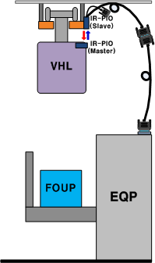
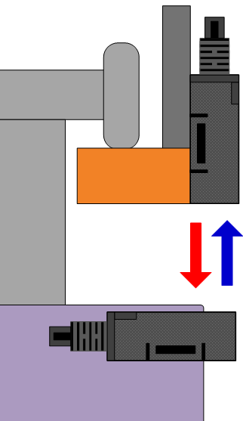
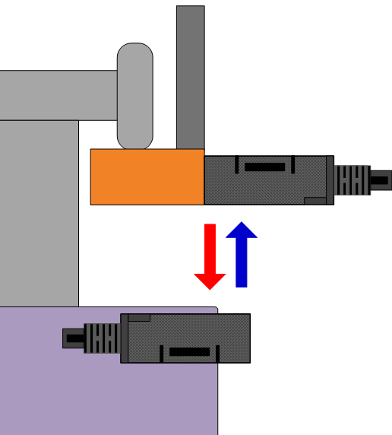
1. IR-PIO Intro (1)
  1) System Specification
    EQ PIO : E84 Communication Device
    PMAN (PIO Manager) : PIO Multi Function Hand Terminal
    WinPMAN : PIO Communication Analysis Program
    Emulator : E84 PIO Sequence Tester (Manual / Auto)
IR-PIO(Slave)
_Top View
IR-PIO(Slave)
_ Front View
IR-PIO(Master)
_Front View
IR-PIO(Master)
_Front View
< IR-PIO Installation>
< IR-PIO Communication Direction >

Slide 4
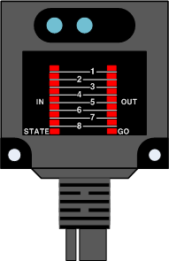
1. IR-PIO Intro (2)
  2) PIO Internal Structure
    IR Transmitter/Receiver Circuit : Compatible with existing product.
    RF Transmitter/Receiver Circuit : 2.4GHz WIFI, Data, F/W transmitter-receiver.
    Cache Memory : Save Approximately 130~190 communication line.
    Process : Control PIO, Save Communication Wave in process memory
    Serial : Set up PIO & Data Transmitter/Receiver channel.
    Display LED : GO LED, Status LED
IR LED
Photo Sensor
IN
PIO In Signal
Output
RF
Circuit
Out circuit
OUT
PIO Out Signal
Process
Input Circuit
Input
IR LED
Level Cotrol
Serial
GO
IR Communication signal
Signal
IR
Circuit
Cache Memory
Photo Diode
STATE
PIO Status
< IR-PIO Internal Structure>
< IR-PIO External Structure>

Slide 5
1. IR-PIO (3)
  3) Product Feature
    It works stable in the environment of high frequency noise from fluorescent lamp
    It has superior tolerability about electromagnetic waves.
    It has safety verification. (Tested in variety of environment)
    2.4GHz wireless communication : It can upload/download data without high place work.
    Provide E84 communication error analysis.
      We have experience of e84 communication analysis by installing RF PIO for many years
      Support Easy Analysis program and Log Data
      Support Saving 190 Line Log data with sufficient memory
      Easy to check signal timing error and provide noise analysis
      (F/W Download : Function/Performance improvement (Wireless or RS-232)
    Real time saving data of Communication : RS-232C
    High performance control signal by rapid CPU and sufficient memory
    Sub Device : PMAN, E84 Emulator, WinPMAN
    Caution - Installation
      Align PIO sensors, VHL and tools
      Check the surrounding noise from fluorescent lamp
      Do not allow any metals near RF antenna

Slide 6
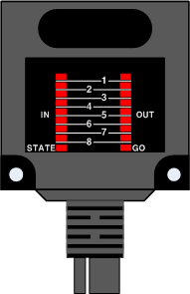
2. IR-PIO Function(1)
  1) Status of Turn On : State LED
  2) IR-PIO Communication Status (Equipment PIO)
    GO LED : Start E84 PIO between VHL and Equipment E84
    OUT LED : VHL Output Signal
    IN LED : Equipment Output Signal
1
2
3
1
2
3
On
Slave(EQ)
1sec
5sec Off
3sec Off
Off
1
2
3
On
► Check Normal Status
► Check Master/Slave
Master(VHL)
Off
0.25sec
1.25sec Off
► Check LED light location.
► Check normal photo sensor on/off
IN
Equipment Out Signal
OUT
VHL Out Signal
GO
LED On – Active IR Com
STATE
LED Blank – Device Normal
< Equipment IR-PIO >

Slide 7
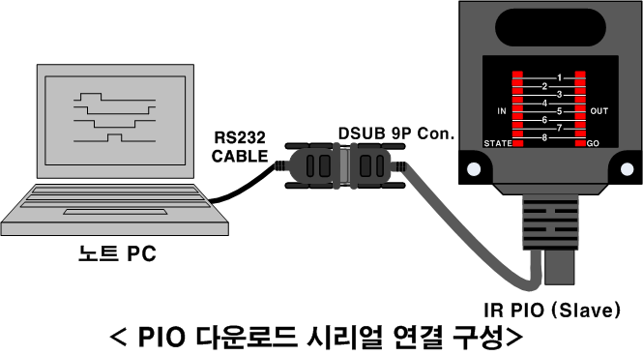
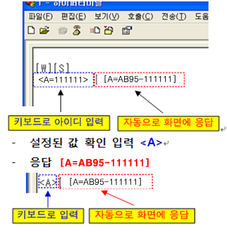
2. IR-PIO Function(2)
  3) PIO Main Function Set up (Serial Command)
    Set up Port : RS-232 Port
    Serial default Value
      8bit, No Parity, Baud rate 57600, Stop bit 1
    Function : Wireless com ID set up, Time set up, Version
    4) Serial Command
    Data Format
      Use hyper terminal to transfer a command.
< PIO Hardware>
<Command>
[Reply]
Func | Command (PC) | Check Value | Response (PIO)
ID | <A=123456> | <A> | [A=AB95-123456]
Channel | <C=16> | <C> | [C=16]
Time | <T=14/09/29 09:23:20> | <T> | [T=14/09/29 09:23:20]
F/W Version | - | <V> | [2.31]
Debugging | <D=0> | <D> | [D=0]
 | <D=1> | <D> | [D=1]
< Example ID set up>

Slide 8
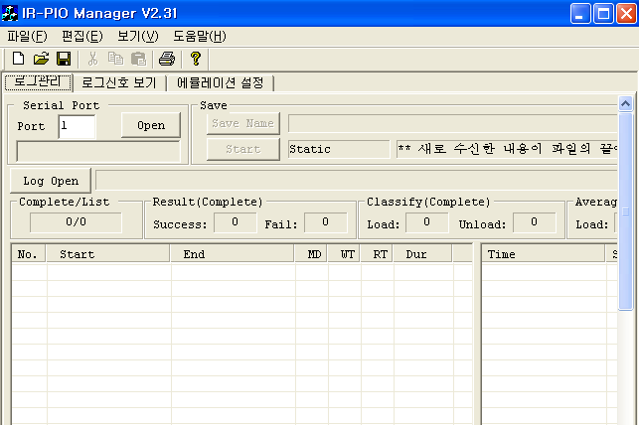
2. IR-PIO Function(3)
  5) Down load Communication Data
    Connect PIO Sensor to PC by RS232C.
      Time Compensation Function : Auto Time Compensation from PMAN.
    Down load Data from IR-WinPMAN program
      IO Status Checking (Power & Com Status)
      Check real time data between VHL to equipment by Saved data from Equipment PIO.
      Analyze Communication Error by Noise or Others.
< PIO Hardware >
< Data Analysis Program >

Slide 9
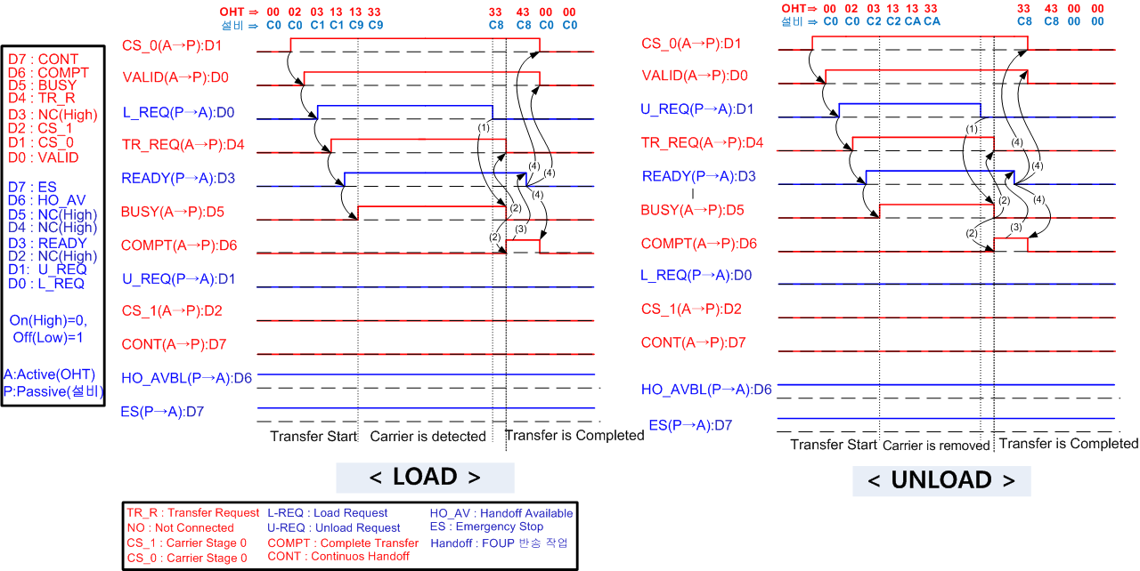
3. IR-PIO E84 Sequence Chart

Slide 10
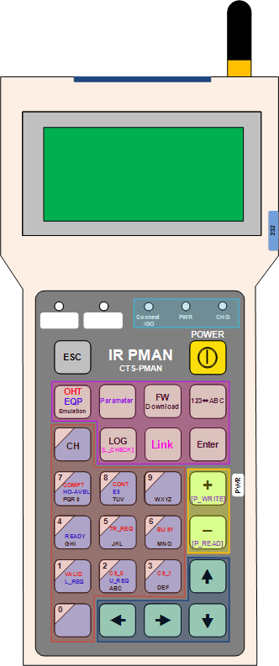
4. IR-PMAN
  Feature & Function
    PIO Status checking by Wireless Communication
    Control E84 Communication by IR & RF.
      Easy to control PIO signal in Long distance.
      Save time to check PIO signal.
    Download PIO log from Device.
      Download transfer communication data by wireless
    F/W Download
      Easy to update Firmware without hardware exchanging
    Set up Parameter
      PIO F/W Version, RTC set up, Monitoring,.. Etc.
    OHT/EQP Emulator
      Auto/Manual SEMI-E84 EMULATION
      E84 Signal Timing Set up for EMULATION
IR Com.
RF Com. Antena
LCD Display
RS 232 CON.
LED DISPLAY
Power
Perivious
Set up Function
Power Adapter CON.
Parameter Set up
Input Keys
Cursor
< PMAN >

Slide 11
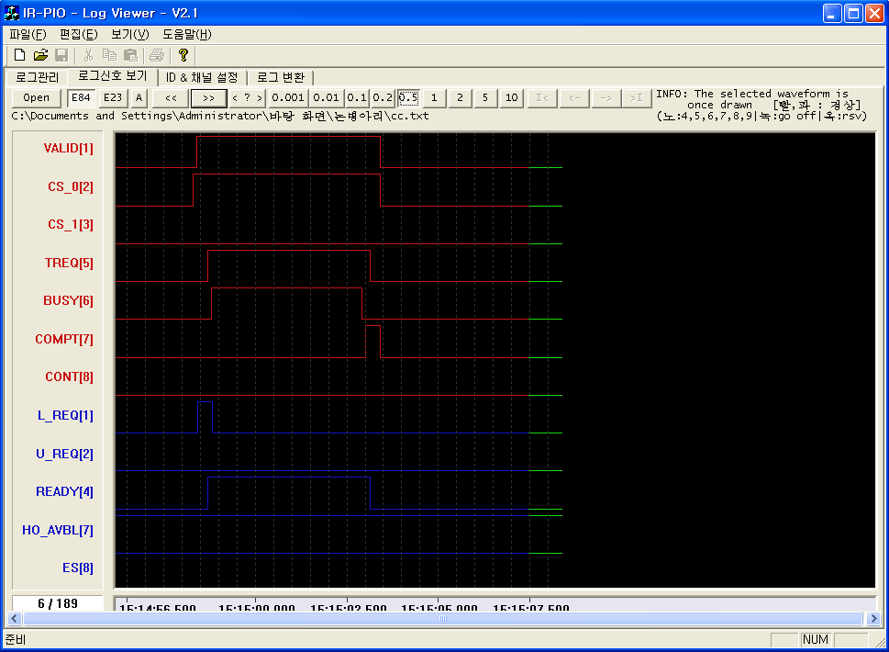
5. WinPMAN
  1) Data Analysis Program
    Viewer Program (WinPMAN) – Check E84 Signal Sequence.
      Statistical Analysis : Min/Max Time, Avg. Time, Sorting, etc
      Error table : Sorts out Timing error and IR error
      Analyze external light and noise in addition to active signal (Noise signals with yellow)
    PIO data log : Save up to 190 FOUP handling data
    PIO data graph : Display PIO sequences
    <PIO data log>
    <PIO data graph>

Slide 12
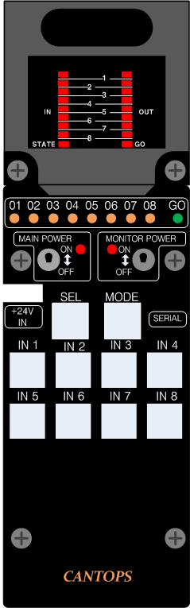
6. Emulator
  1) PIO Signal Generator
    Virtual simulation without VHL or equipment
    following the regulations of SEMI-E84
STATE
PIO Status
IN
Equip. In Signal
OUT
VHL Out Signal
GO
IR Com. Signal
MAIN POWER
MONITOR POWER
External PIO Power.
+24 Power Input Connector
Serial connecttion
SEL
Activation Switch
MODE
OHT, EQP Mode
Valid
CS_0
OHT Input Signal
TREQ
BUSY
COMPT
CONT
< PIO SIGNAL GENERATOR >

